Slide 1
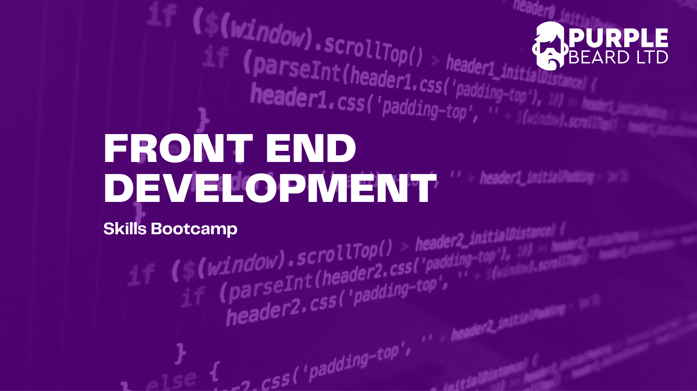
JavaScript 1

Slide 2
Number Exercise 1: Age Logger
Add an external JavaScript file to your HTML page
Use the let keyword to declare a variable of age
Set the variable age to your age
Console log the variable

Slide 3
Number Exercise 2: So Many Rabbits
Number Exercise 3: BODMAS
Define a variable numberOfRabbits as 2
Set the variable to 3 * the previous number
Console log the result
Assign a variable with a name bodmasExample to 3
Add 5 to the variable and divide the result by 6
Console.log the result

Slide 4
Number Exercise 4: Random Number Generator
Use the maths objects to create a random integer between 1 and 6
Console.log your result

Slide 5
String Exercise 1: Log your country
String Exercise 2: String Length
Define a variable myCountry and give it a value of your country
Console log the variable
Log the length of your country using the length property.

Slide 6
String Exercise 3: Upper Case
String Exercise 4: Lower Case
Define a variable favouriteFood and give it a value of your name
Use a method to change favouriteFood to all upper case
Console log the result
Change favouriteFood back to all lower case using a method and console.log the result

Slide 7
String exercise 5: Concatenation
Set your name as a variable​
Set your age as a variable​
Define a new variable, message using concatenation as “Hello my name is myName and I am myAge years old” to the console using concatenation.​
Try changing the variables and console logging
Append the string "What is your name?" To the message variable

Slide 8
String exercise 6: Template Literals
Define Variables firstName and lastName
Use template literals to log the names with a space in between
Use a template literals to log a welcome message with a line break:
`Welcome firstName lastName,
How can I help you?`

Slide 9
Control Flow Exercise 1: Password Check
Create a variable, password
Write an if statement which console logs true if the password is over 7 character or false otherwise.
Notes:
Strings have only one property called length
Properties are different than methods which we will see later Methods

Slide 10
Control Flow Exercise 2: Height Test
To go on the Super Dooper Looper roller coaster you have to be equal or above 150cm
Use an if/else statement to log "You can go on the ride" if the variable height is equal or above 150 or "Sorry you are not tall enough" height is below 150
Modify your if statement so that if height is not a number the message "Please enter a number" is logged to the console
Notes:
Strings have only one property called length
Properties are different than methods which we will see later Methods

Slide 11

If Statement Project: Dice Prize
In the game Dice Prize, you throw two dice:
If you throw two sixes you win a top prize: a bear
If you throw a double number, other than a six, you win three free throws
If you throw an even number, you win one free throw
If you throw any other combination, you lose the game
Use Math.random, if, else, else if and template literals to create the game and console log what the player wins or whether they lose
Start by writing a flow chart on paper to plan out your code
If you finish early, you can incorporate alert and prompt into the game
Notes:
Strings have only one property called length
Properties are different than methods which we will see later Methods

Slide 12
Functions Exercise 1: Simple Function
Write a function with no parameters that returns the string “Hello World”
Try console logging the function

Slide 13
Function Exercise 2: Quadrupler
Create a function called “quadrupler”
The function should take in one parameter
The function should return 4 times the parameter
Try console logging the function with different numbers as parameters

Slide 14
Function Exercise 3: Welcome Message
Create a function called welcome. The function should take two parameters: firstName and lastName
The function should return the string `Hello firstName lastName, how can I help you?`
Try console logging the function with your name as a parameter
Finally modify the function so that the firstName is in lower case but the lastNames is in all capital letters

Slide 15

Function Exercise 4: Temperature Converter
Create a function called temperatureConverter
The function should take in one parameter called Fahrenheit
The function should return the temperature in Celsius using the following formula:
Celsius = (Fahrenheit - 32) × 5/9
Try console logging the function with different numbers as parameters

Slide 16
Function Exercise 5: Dog Years
Information
The first year of a dog's life is equal to 15 human years
The second year of a dog's life is equal to nine human years
Each additional year is equal to about five human years
Instructions
Use your age and name variables​
Calculate your age in dog years using JavaScript maths operators​
Console log your age in dog years using template literals

Slide 17
Function Exercise 6: Calculator
Create a function called calculator which takes three arguments
Check the first and third arguments are numbers. If they are not numbers, log an error to the console
Check the second argument is a string of either +, -, * or /. If it is not log an error to the console.
Use if and else statement to perform the correct calculation and return the correct answer depending on the second argument
Try Console logging your calculator function with different arguments and see what happens.
Notes:
Strings have only one property called length
Properties are different than methods which we will see later Methods

Slide 18
Function Exercise 7: Less than
Write a function “min(a, b)” which returns the lesser of the two numbers “a” and “b”.
For instance:
min(1, 2) == 1
min(10, 100) == 10
min(1, 1) == 1
Notes:
Strings have only one property called length
Properties are different than methods which we will see later Methods

Slide 19
Function Exercise 8: To the power of
Write a function “pow(x, n)” that returns “x” in power “n”. In other words, it will multiply “x” by itself “n” times (xⁿ) and returns the result.
pow(2, 2) = 2 * 2 = 4
pow(2, 3) = 2 * 2 * 2 = 8
pow(1, 100) = 1 * 1 * …x97 * 1 = 1
Notes:
Strings have only one property called length
Properties are different than methods which we will see later Methods

